Slide 1

Assignment 1
Chetan Sahrudhai Kimidi
CSCI-B 649: cyber defense competitions
10.17.2023
Indiana University Bloomington

Slide 2

Automatic sql injection
Blind SQL Injection
Manual and Automatic Exploiting
SQLi Script Building - Demo
Further Modifications

Slide 3

Blind sql injection
This is a type of SQLi attack, which asks the database true/false questions and determines the answer based on the response.
In this case, the response showing “user already exists” was the true case, while the response of “user created” was the false case.
This mechanism has been repeatedly exploited throughout the assignment, to go through all tasks and finally obtain Tom’s password.

Slide 4
A script to automate the process

Slide 5

But, Why?

Slide 6
Because…
Manual
Automatic
Extremely time-consuming
Waste of efforts, for similar cases
Chance of human errors, such as typos etc.
Enables more specialized testing, but at a cost
One script repeatedly carries out the desired injection, to obtain the result
Time-efficient and smart
Can always be modified for various use cases, within less time
Possibility of overlooking a few vulnerabilities

Slide 7
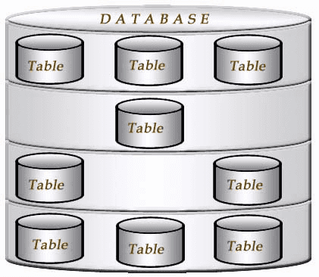

tasks
Finding the table names
Finding the columns in the target table
Finding the users and a particular value (password)
select TABLE_NAME from INFORMATION_SCHEMA.TABLES
select TABLE_NAME from INFORMATION_SCHEMA.COLUMNS where COLUMN_NAME = 'PASSWORD'
select COLUMN_NAME from INFORMATION_SCHEMA.COLUMNS WHERE TABLE_NAME = 'CHALLENGE_USERS'
select USERID from CHALLENGE_USERS
select PASSWORD from CHALLENGE_USERS where USERID = 'tom'

Slide 8
DEMO TIME!

Slide 9

References
OWASP WebGoat
Information_Schema
W3Schools SQL
SQL Server Tips
All images properly hyperlinked!

Slide 10


THANK YOU!
Chetan Sahrudhai kimidi
ckimidi@iu.edu

